Slide 1
COPADS
#7 – Client-server Networking
IFEOLUWATAYO IGE

Slide 2
Outline
Client-Server Architectures
Data Encoding Methods
JSON
MVC/REST Architecture
ASP.NET Basics
Routing
Web Sockets

Slide 3
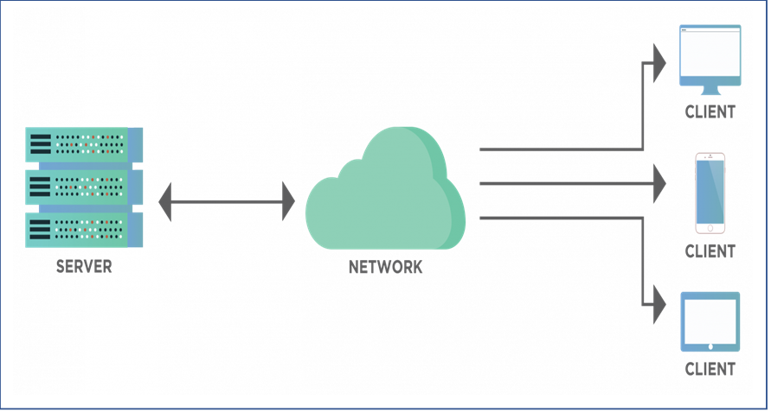
Social Media Platforms and Connections
Twitter, Facebook, Google, Online Banking Portal etc.
Many of us connect to one or more of the above services but how does the data get from them to you?
They can be accessed from multiple places and the information is always the same
They all make use of the Client-Server Architecture

Slide 4
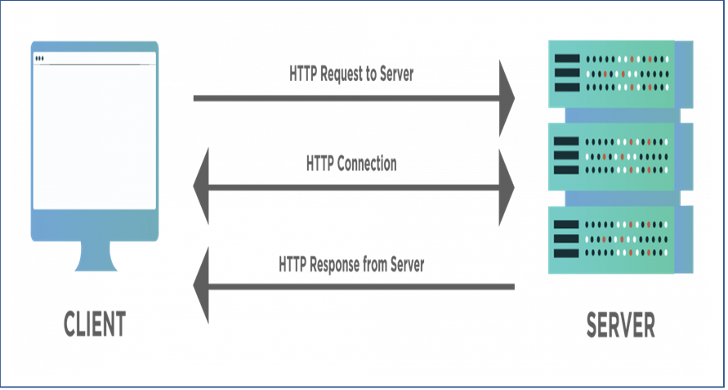
Example: You are going to shop for groceries from your home to a grocery store across the road with a bicycle.
Who is the server? And who is the client?
The street/road between your home and the shop?
Bicycle?
The shop Address?
The communication language between you and the salesman?
Your order?
The HTTP communication protocol helps establish the connection between the client and the server.
The client sends an HTTP request, for which the server sends an HTTP response.
Difference between TCP and HTTP?
TCP: is a transport-layer protocol which manages the data stream
HTTP is an application-layer protocol that runs over TCP. It describes what the data in the stream contains

Slide 5
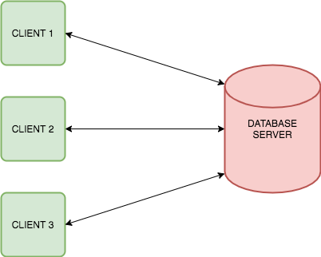
Client-Server Architecture-Types
1-Tier Architecture: The client and server applications are on the same system. All settings are on a single device. Data is stored on a local file or a shared driver
2-Tier Architecture: The user interface resides on the client side while the database is on the server side. The database and business logic can be stored at the client or the server end, but they must remain unchanged.
The performance of the application degrades with increasing users (clients).
When simultaneous client requests are made, application performance degrades rapidly because each client requires a separate connection which means increased CPU memory.
Less security.

Slide 6
Pros:
It maintains data at one central location.
It provides backup and data recovery options.
Cons:
The client is open to attack from viruses on the server.
Internet outage.
Possibility of loss of data packets either completely or modification because of some intrusion during the transmission, hardware issues
Numerous requests simultaneously can cause “traffic congestion problems”.

Slide 7
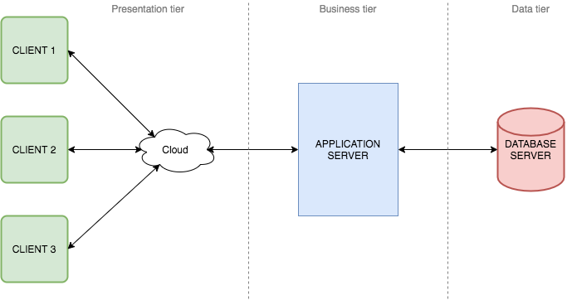
3-Tier Architecture: This consists of the presentation tier or user interface; the application tier, where data is processed; and the data tier, where the data associated with the application is stored and managed.
Pros:
Faster development: Each tier can be developed simultaneously by different teams,
Improved scalability: Any tier can be scaled independently of the others as needed.
Improved reliability: An outage in one tier is less likely to impact the availability or performance of the other tiers.
Improved security: Because the presentation tier and data tier can't communicate directly, a well-designed application tier can function as a sort of internal firewall, preventing malicious connections.
Con: It is expensive

Slide 8
Data Encoding Methods
Object encoding:
Data represented as objects with/without attributes
JSON and XML use object encoding
Binary Encoding:
Data sent as raw bytes sent over the network
Minimizes message sizes
Not human-readable
Used by DNS
Text Encoding:
Text strings are sent over the network
Human readable
Larger than binary encoding
Used by SMTP

Slide 9
JSON: Data Format for Communication
JSON- JavaScript Object Notation
JSON uses human-readable text to store and transmit data objects.
Used for data exchange, easy to understand, has support for almost all scripting languages
JSON defines only two data structures: objects and arrays.
Objects are a set of property names and value pairs, represented with { }
They are encoded as strings
Array is a list of values represented with [ ].
Newtonsoft JSON is the JSON framework for .NET
It can be added by clicking Project and selecting Manage NuGet Packages.
Add a “Newtonsoft.Json”: “12.0.2” (or newer) dependency to the project.

Slide 10
JSON: Data Conversions
Serialization is a process of converting objects into a stream of bytes.
Why do we need to serialize:
Objects should be converted into a format that can be easily stored or transmitted over a network
Different systems can communicate by serializing objects into a common format that can be understood by different platforms and programming languages.
Deserialization is the complement of serialization which is performed to recover the original object from the byte stream.
Syntax:
Serialization: JsonConvert.SerializeObject(<object>)
Deserialization: JsonConvert.DeserializeObject<type>(<string>)
(As seen in 07-02)

Slide 11
Sending and Getting Data over a Network
To Send:
Start a server, Wait for the client to connect, Serialize the data, Write it to the TCP client, and use the dispose method to end the stream.
See 07-03
To Receive:
Read all the data from TCPClient (use ReadToEnd()) then Deserialize and you will have the object!
See 07-04

Slide 12
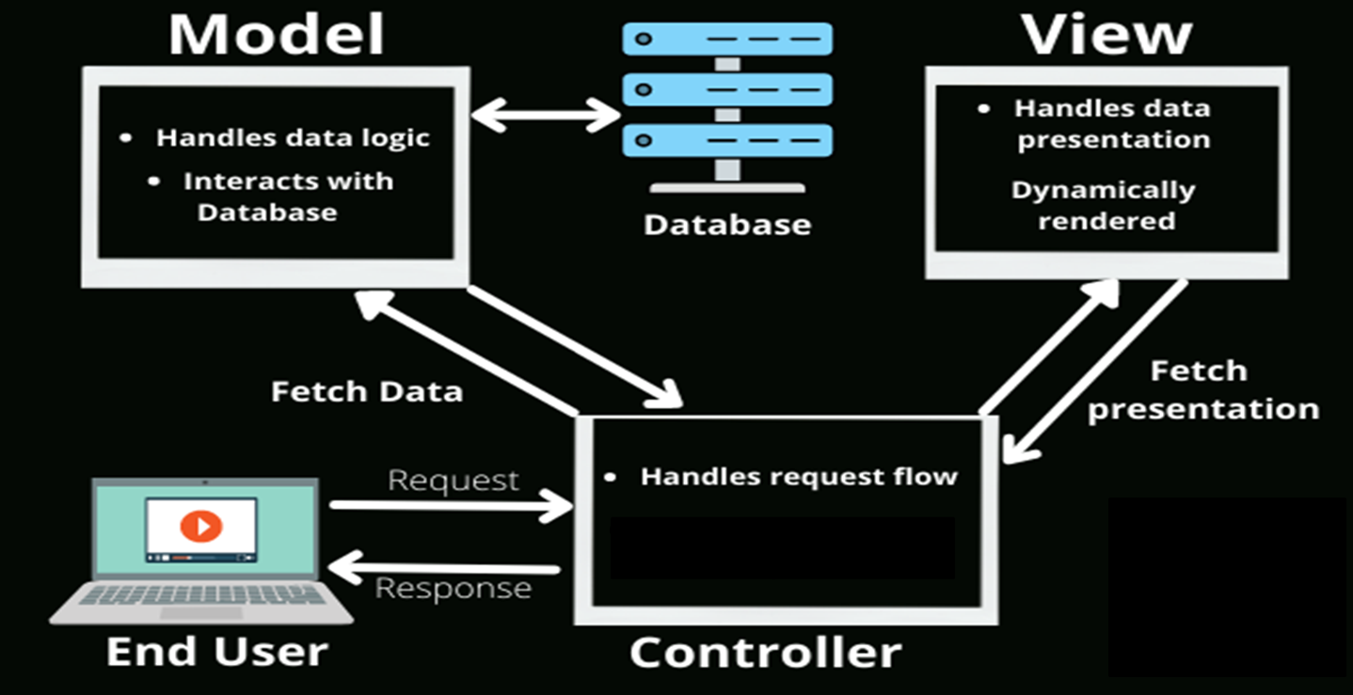
ASP.NET
ASP.NET(Active Server Pages) is an open-source web framework for building modern web apps and services with . NET. It is designed to work with the HTTP protocol
It is based on the Model-View-Controller (MVC) architecture which breaks up a complex user web application into smaller manageable components.
Using the MVC helps to create scalable and extensible web projects.
The MVC Architecture

Slide 13
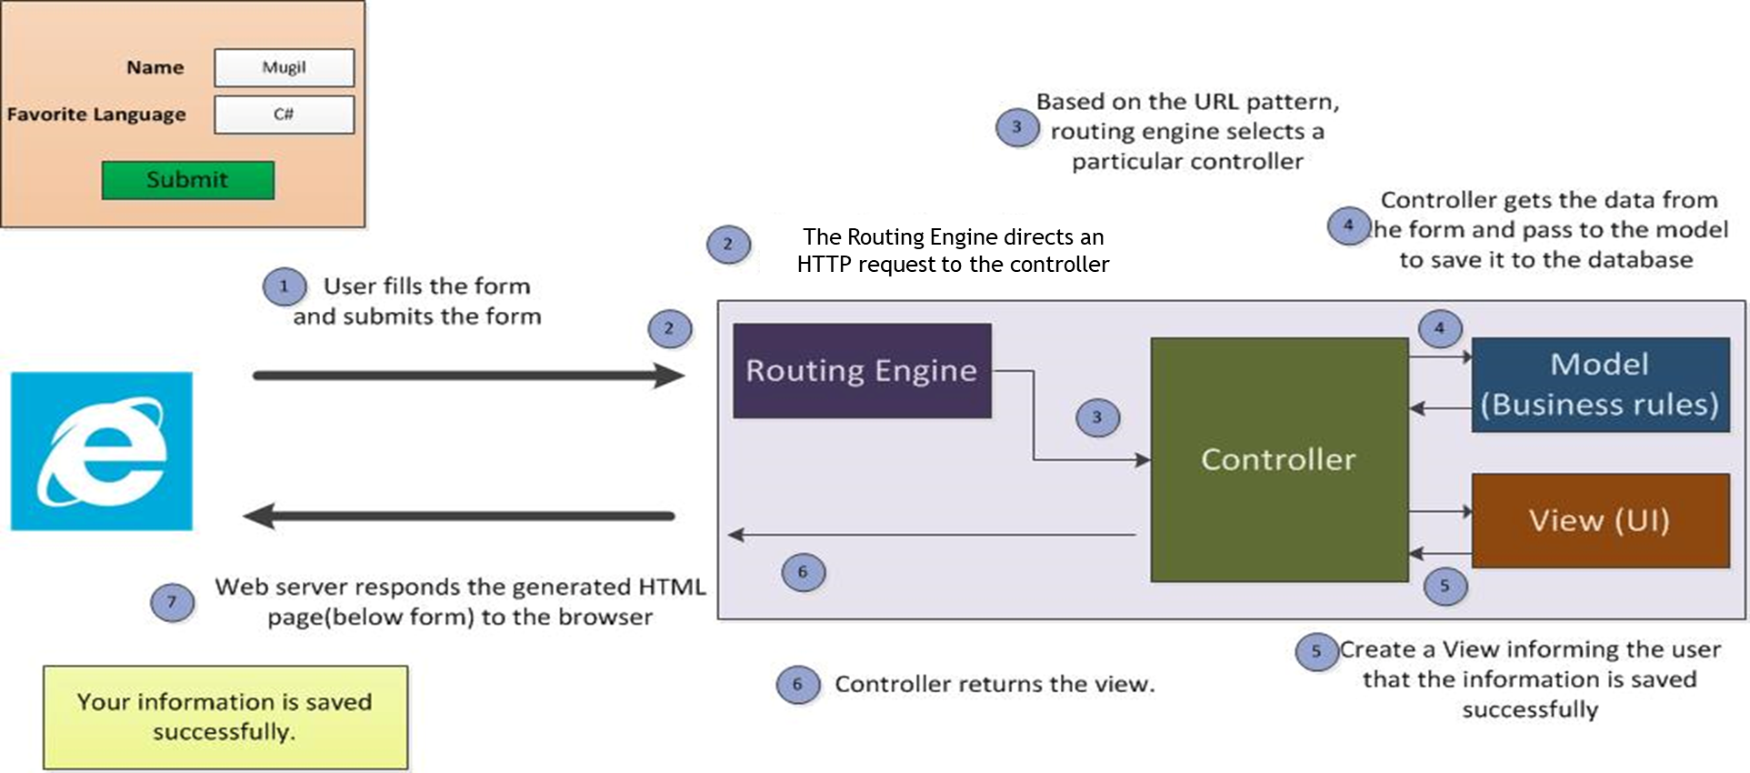
An Example showing data passed from View to Controller in ASP.Net MVC
Routing directs an HTTP request to the appropriate controller. This is implemented by importing the System.Web.Routing namespace
https://www.dotnetodyssey.com/2015/04/24/pass-data-from-view-to-controller-in-asp-net-mvc/

Slide 14
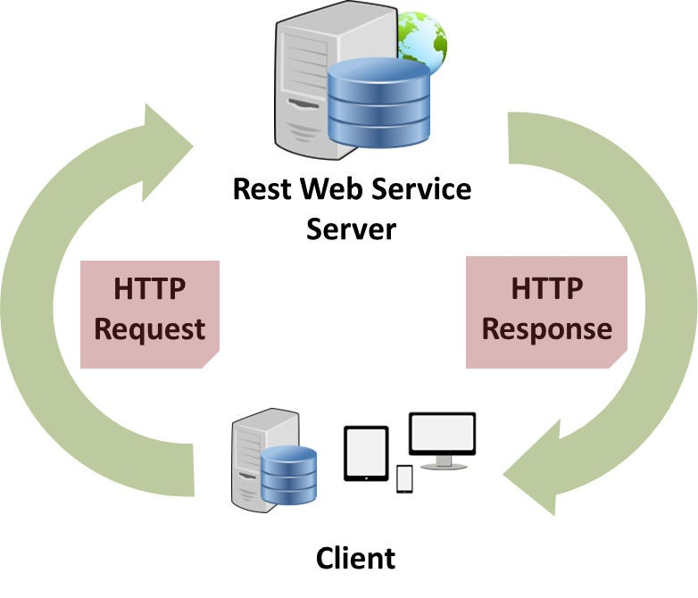
REST- REpresentational State Transfer
REST is an architectural pattern for designing and interacting with web resources, such as data, images, or documents.
RESTful APIs use HTTP methods (GET, POST, PUT, DELETE) to perform CRUD (Create, Read, Update, Delete) operations on web resources. RESTful APIs also use standard formats, such as JSON or XML, to exchange data between the client and the server.
Some web development frameworks support MVC and REST APIs
REST APIs provide modules and libraries to create web services and for communication between nodes.
MVC provides structure and manages the web application logic.
For instance, in a web application, a route may map to a controller method that returns user data in JSON format while the REST framework can validate input, serialize output, authenticate users, and handle errors.

Slide 15
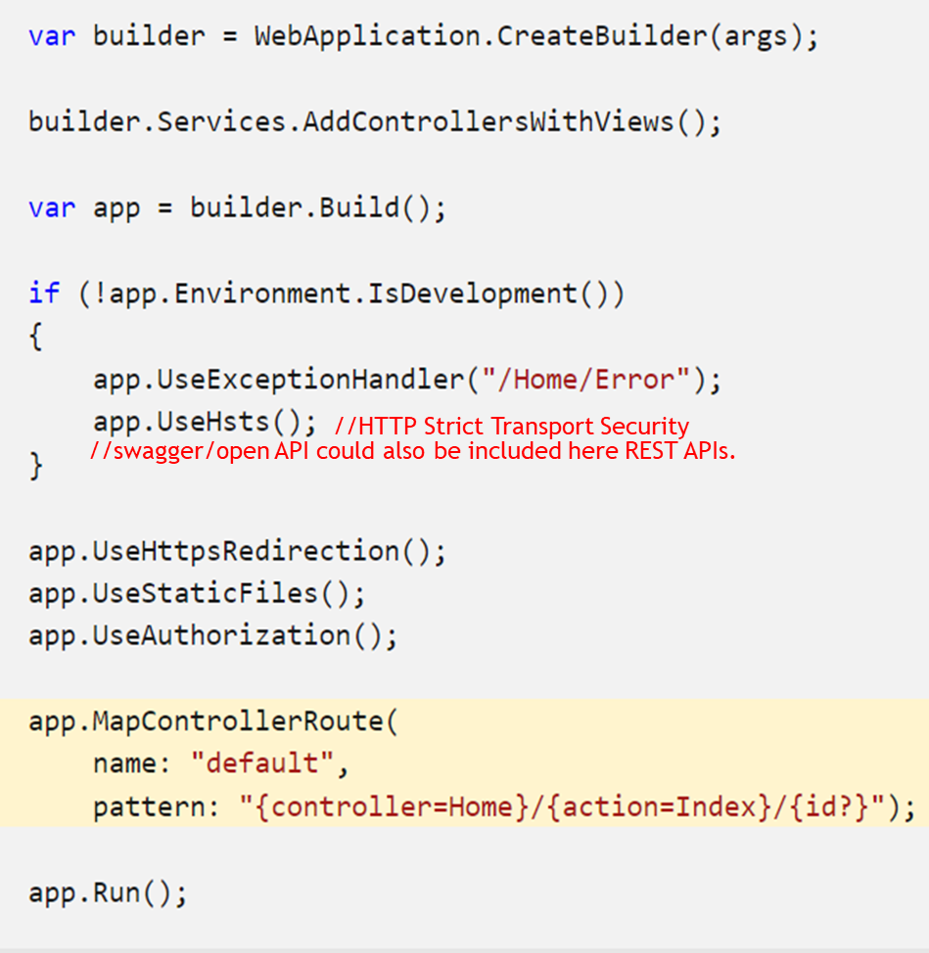
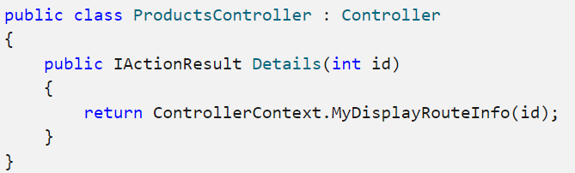
Routing
Controllers use the routing middleware to match the URLs of incoming requests and map them to actions in the program.cs
Actions are either conventionally-routed or attribute-routed.
The above code is called Convention-based Routing because it establishes a convention for all URL paths.
MapControllerRoute is used to create a single route. The single route is named the default route.
Matches a URL path like /Products/Details/5.
Extracts the route values { controller = Products, action = Details, id = 5 } by tokenizing the path.
The extraction of route values results in a match if the app has a controller named ProductsController and a Details action
https://learn.microsoft.com/en-us/aspnet/core/mvc/controllers/routing?view=aspnetcore-8.0

Slide 16
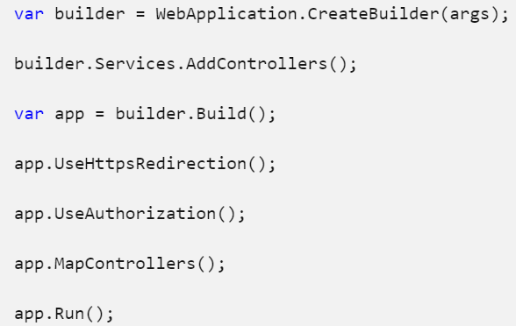
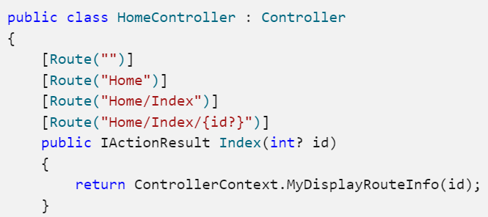
Attribute Routing uses a set of attributes to map actions directly to route templates. This makes your code more explicit and reduces routing errors if used.
In program.cs, MapControllers is usually called to map attribute routed controllers.
The HomeController.Index action is run for any of the URL paths /, /Home, /Home/Index, or /Home/Index/3.
You can create a new asp.net mvc, or asp.net web api on Visual Studio.

Slide 17
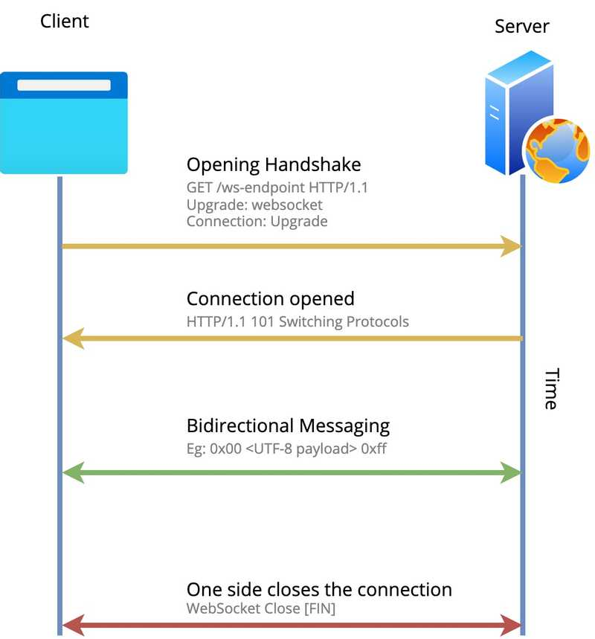
Web Sockets
A WebSocket is a communication protocol that provides a full-duplex communication channel.
Useful for real-time web applications where uninterrupted transmission of data is required.
Examples: bitcoin trading websites. Other examples?
The protocol has two parts: Handshake and Data Transfer.
Handshake Procedure:
server listens for incoming TCP socket connections
The client initiates the opening handshake with an upgrade request to a web socket.
The server sends a handshake response to the client stating a change in the protocol from HTTP to WebSocket.
Both client and server negotiate the connection details.
Either of the parties can close the connection

Slide 18
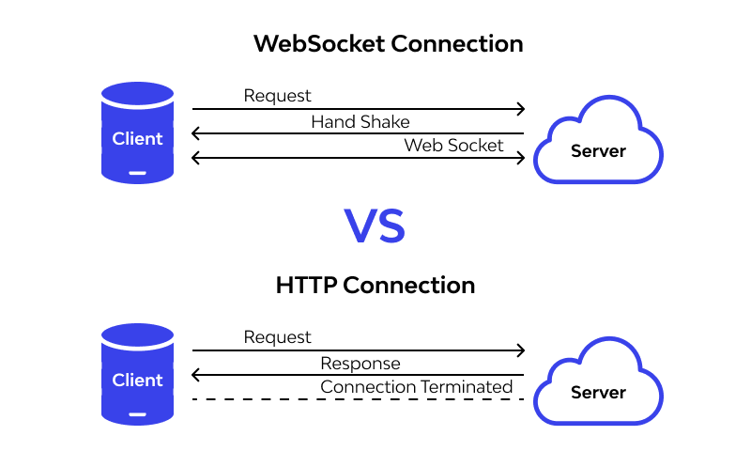
Web sockets Example
Time Display
Web1 (server)
Web 2 (client)
C# WebSockets Tutorial: Build a Multiplayer Game https://developer.okta.com/blog/2019/11/21/csharp-websockets-tutorial
Discussion: Any difference between HTTP and web sockets?

